Slide 1
CloudBees Jenkins Analytics

Slide 2
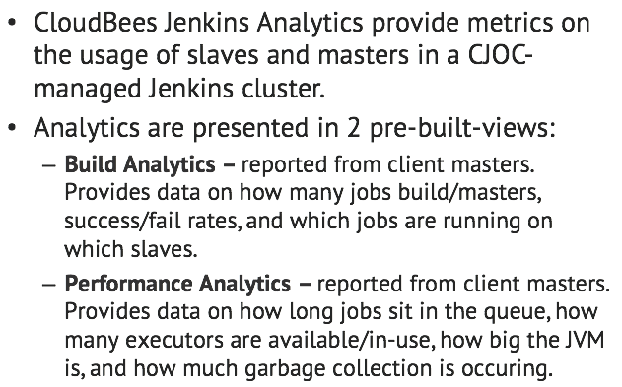
What is CloudBees Jenkins Analytics?

Slide 3
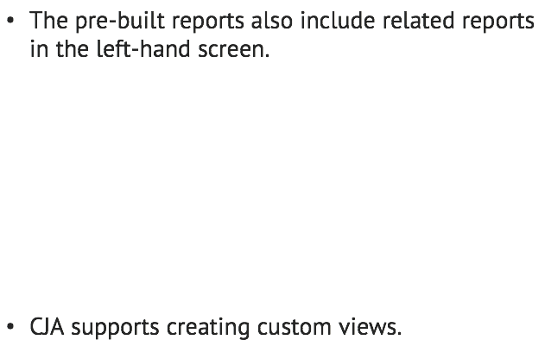
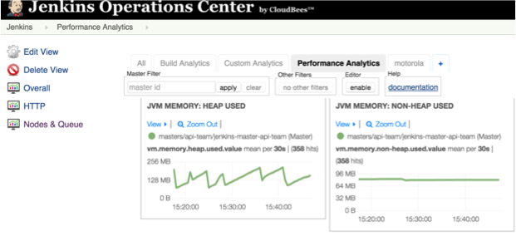
What is CloudBees Jenkins Analytics?

Slide 4
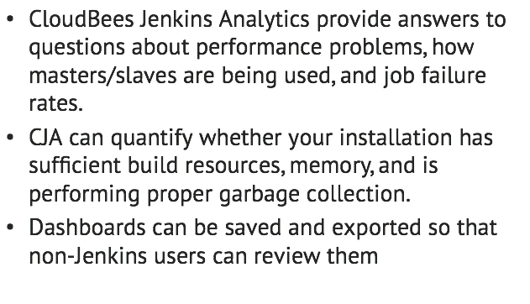
Benefits: installation insights

Slide 5
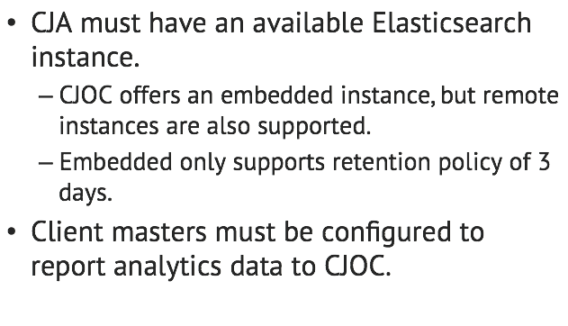

Where do we start?

Slide 6
Lab Exercise:
<labName>

